Slide 1

PREDICTION OF AIR QUALITY INDEX USING MACHINE LEARNING
Presented By:
Vasu Bansal. 35311503119
Sayyam Jain 02311503119
Rohan Khilnani 00411503119
Guided By:
Punit Singh Lamba

Slide 2
ABSTRACT
Air pollution is the largest environmental and public health
challenge in the world today. Air pollution leads to adverse effects
on Human health, climate and ecosystem.
Air is getting polluted because of release of Toxic gases by industries, vehicular emissions and increased concentration of harmful gases and particulate matter in the atmosphere.
Particulate matter is one of the most important parameter having the significant contribution to the increase in air pollution.
So in order to prevent us to expose from air pollution we need to predict air quality priorly and take necessary action.

Slide 3
OBJECTIVES
Aim of the Project:
The goal is to develop a machine learning model for real-time air quality
forecasting, by comparing the accuracy using supervised machine learning
techniques like linear regression, Lasso regression, support vector regression.
Scope of the Project:
The project can be used to monitor the air quality index of a particular area and to predict the air quality and we can try to control the pollutants by taking necessary steps to avoid bad air quality.

Slide 4
INTRODUCTION
In the last decades, along with the rapid development of the
industrialization and urbanization, the increasing level of air
pollutant concentrations has been a growing rapidly.
In the developing countries like India, the rapid increase population
in cities have lead to environmental problems such as air pollution.
Machine learning is method of data analysis that automates analytical model building.
> It is a branch of artificial intelligence based on the idea that systems can learn from data, identify patterns and make decisions with minimal human intervention.

Slide 5
LITERATURES REVIEW
Alireza Rahimpour, Jamil Amanollahi, Chris G. Tzanis,
> In this paper they have used three types of techniques, Hybrid single decomposition (HD), Hybrid two-phase decomposition(HTPD), Variational mode decomposition(VMD).
>HTPD model was the highest in the training, phase and testing phase,
So it has been concluded that HTPD technique have more accurate results.

Slide 6
LITERATURES REVIEW
K. Mahesh Babu, J. Rene Beulah, "Air Quality Prediction
based on Supervised Machine Learning Methods," International
Journal of Innovative Technology and Exploring Engineering (IJITEE)
ISSN: 2278-3075, Volume-8, Issue-9S4, July 2019.
Generally, Air pollution alludes to the issue of toxins into the air that
are harmful to human well being and the entire planet.
The air quality dataset is preprocessed with respect to univariate
analysis, bi-variate and multi-variate analysis, missing value
treatments, data validation, data preparing

Slide 7
LITERATURES REVIEW
Ranjana Waman Gore, Deepa S. Deshpande, "An Approach
for Classification of Health Risks Based on Air Quality Levels,"
IEEE,2017.
This paper focuses on analysis of air based on the available data of
various air pollutants such as NO2, SO2, CO and 03.
This paper implements Naive Bayes and Decision tree J48
algorithm for predicting the health concern.
The result shown that decision tree algorithm gives 91.9978 % accuracy.

Slide 8
DESIGN AND METHODOLOGIES
MODULE 1:
Data Collection and Processing of the Data
MODULE 2:
Applying the machine learning algorithms

Slide 9
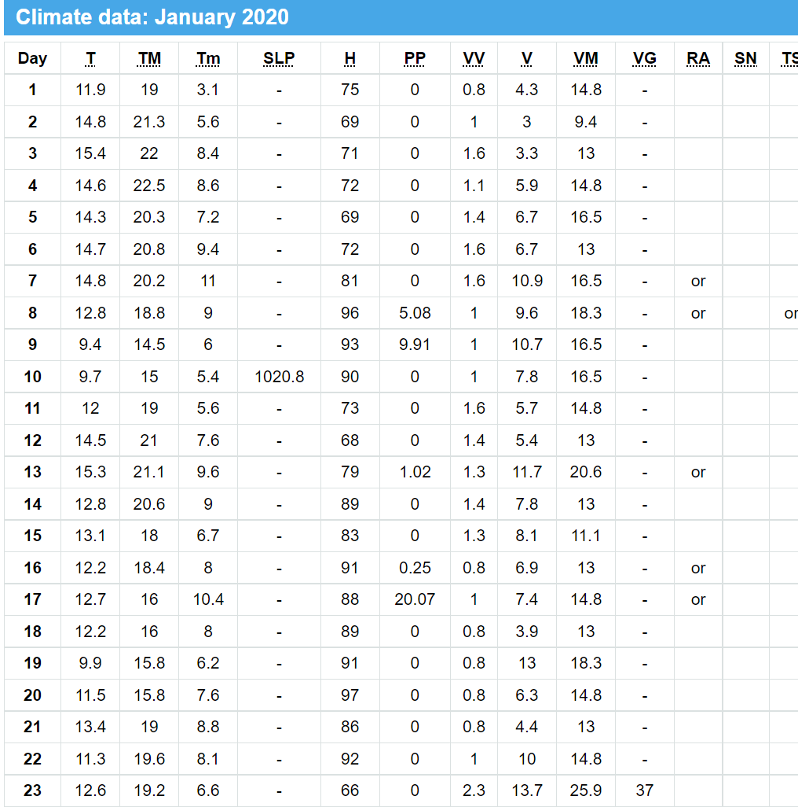
MODULE 1
Data Collection and training using Machine learning Algorithms
STEP :-1 Collection of Data
Weather in New Delhi / Palam during January 2020 - historical climate data (tutiempo.net)

Slide 10
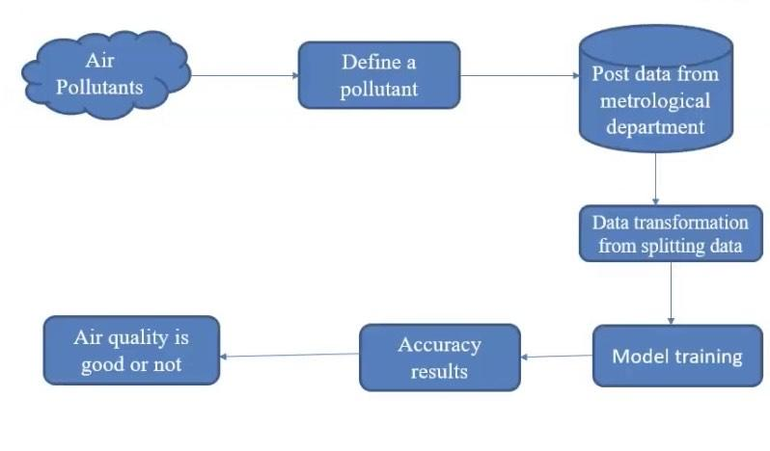
ARCHITECTURE DIAGRAM

Slide 11
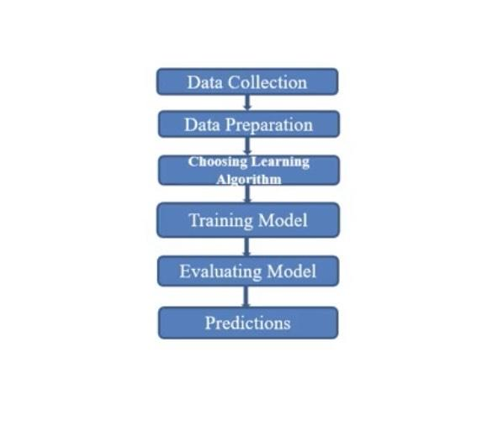
DATA FLOW DIAGRAM

Slide 12
CONCLUSIONS
This study concentrates on the prediction of pollutants present in the air.
Data collection will be done from various resources and suitable data will be further analyzed to make the best model for better prediction.
The collected data will be trained using machine learning algorithm.
There after selective algorithms will be applied
on the data and to find the accurate ones for predicting the
air quality.
By predicting the air quality priorly we can take necessary
steps to prevent ourselves from harmful health diseases.

